Slide 1

Power BI Chart Types: Choosing the Right Visuals for Your Data
Dr. Rakhee Chhibber

Slide 2
Questions to ask before selecting a graph
What’s the target audience for my report? Will they be familiar with these visuals?
Is this visual suited for the specific data? Will it portray it accurately? Does it work with the data at all?
What do I want to tell with this visual? Does it provide meaningful insights to the user?

Slide 3
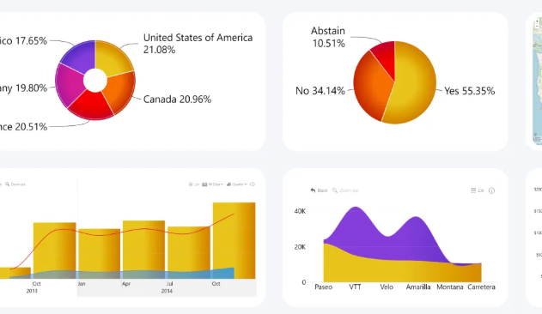
Types of Charts
Donut Chart
Column Chart
Bar Chart
Line Chart
Area Chart
Combo Chart
Time Series Chart
Waterfall Chart
Scatter Chart
Map Chart
Network Chart

Slide 4
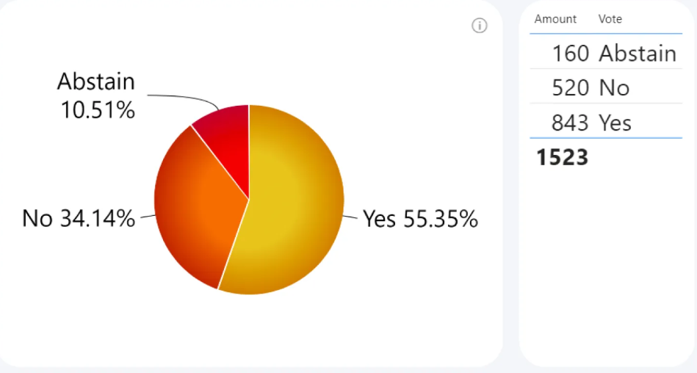
Power BI Pie chart
Pie charts are suited for numerical values in category-based data.
It’s best used to provide a quick overview of how the total value can be separated into subcategories.
For example, if you want to visualize voting data, where out of 1523 people 843 voted “Yes”, 520 voted “No”, and the remaining 160 abstained, the pie chart will show each of these values as appropriately sized slices. Their size will be determined by the percentage of each value compared to the total which must always be 100%.

